Slide 1
Unleashing the Potential of AMCP Foundation Internships: Tips and Insights
Notes:
Paula

Slide 2
Webinar Agenda
AMCP Foundation Internships Overview
  Webinar Moderator: Nikhil Bhatia, 2024 Pharm D Candidate, University of Georgia College of Pharmacy
Vy Do, PharmD, PGY1 Managed Care Resident, Premera Blue Cross
Jenoy A. Merchant, PharmD, PGY1 Resident, FAMU/BMS Pharmaceutical Industry Residency
Amy Wu, PharmD, AESARA/UNC Market Access and Health Informatics Fellow
Raquel Erb, BA, 2024 PharmD Candidate, University of Texas at Austin, AMCP Foundation/Sanofi Specialty Care Intern
Ebony Clay, PMP, Assistant Director, Programs & Development
Q&A
Notes:
Paula – recognize Carl and other members of the subcommittee from AMCP SPC

Slide 3

AMCP Foundation Internships
AMCP Foundation began developing student pharmacists in managed care in 1993.
Programs offered over the years:
AMCP Foundation/AbbVie Specialized Internship in Health Outcomes
AMCP Foundation/Genentech Evidence for Access Internship
AMCP Foundation/Genentech Managed Care Customer Operations Internship
AMCP Foundation/Pfizer, Inc. Managed Care Internship
AMCP Foundation/Pfizer, Inc. Oncology Internship
AMCP Foundation/Sanofi Internship in Specialty Care
AMCP Foundation Managed Care Research & Nonprofit Leadership Internship
AMCP Foundation Internship Addressing Health Equity
AMCP Foundation/The Burchfield Group Health Care Reform Internship
*Programs offered in 2023
Notes:
Notes coming.

Slide 4

2024 AMCP Foundation Internships
Programs available in 2024:
AMCP Foundation/AbbVie Specialized Internship in Health Outcomes
AMCP Foundation/Pfizer, Inc. Managed Care Internship
AMCP Foundation/Pfizer, Inc. Oncology Internship
AMCP Foundation/Sanofi Internship in Specialty Care
*All programs are virtual.
Internship Features (Offered to all interns)
Completion of a capstone research project and virtual presentation to AMCP, AMCP Fdn, BBCIC, JMCP, mentors, volunteers, and sponsors.
Journal Club
Fundamental of Managed Care Certificate Training
Virtual mentor appointment by AMCP Foundation to extend coaching
Peer-to-peer mentoring through Foundation intern exchange
Capstone research presentation at AMCP Nexus
Notes:
Notes coming.

Slide 5



Thank You
2023 Internship Partners
Notes:
Paula

Slide 6
Deadline:
Friday, January 8, 2024 apply.amcpfoundation.org
Apply Now!
Notes:
Paula

Slide 7
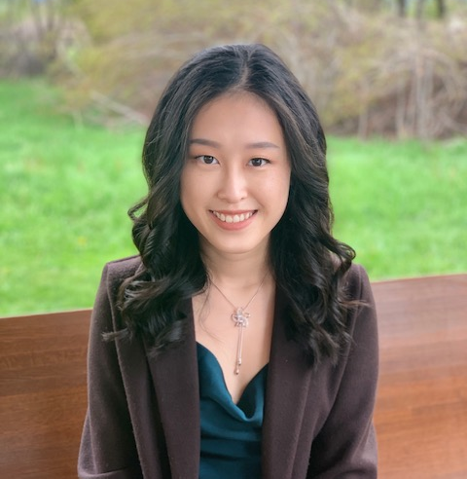
Vy Do, PharmD
PGY1 Managed Care Resident, Premera Blue Cross

Slide 8

About Me
Graduated May 2023
Creighton University School of Pharmacy & Health Professions
  Omaha, Nebraska
No prior managed care experience
  Undergraduate finance major
Completed two AMCP Foundation internships
  Pfizer & Independent Health
  Genentech

Slide 9
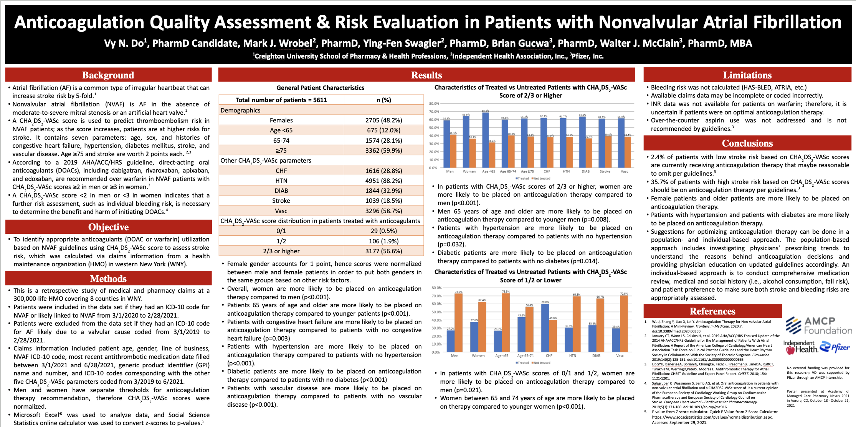
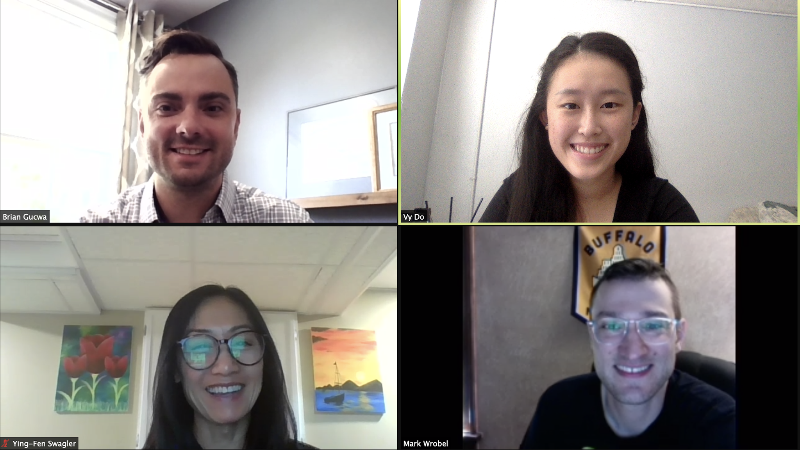
AMCP Foundation/Pfizer, Inc. Managed Care Summer Internship
Summer 2021
Independent Health Associations, Inc.
  Pharmacy Department
    Exposure: Medicare & commercial
Preceptors
  Mark Wrobel, PharmD
  Ying-Fen Swagler, PharmD
  Brian Gucwa, PharmD
Highlights
  First monograph was Aduhelm
  Weekly chats with preceptors – learned A LOT
  Presented Lybalvi at P&T Committee meeting

Slide 10
Additional Projects
Independent Health
Drug monographs and policies
Drug class review
Pfizer
Journal club: mRNA COVID-19 vaccines
Networking
AMCP Foundation
Weekly journal club
Introduction to regulation affairs
Cost-saving analysis
Networking
Weekly virtual training programs
FormularyDecisions/ AMCP eDossiers system demonstration with Xcenda
Networking
VTE Management presentation to the Northeast MOS team

Slide 11
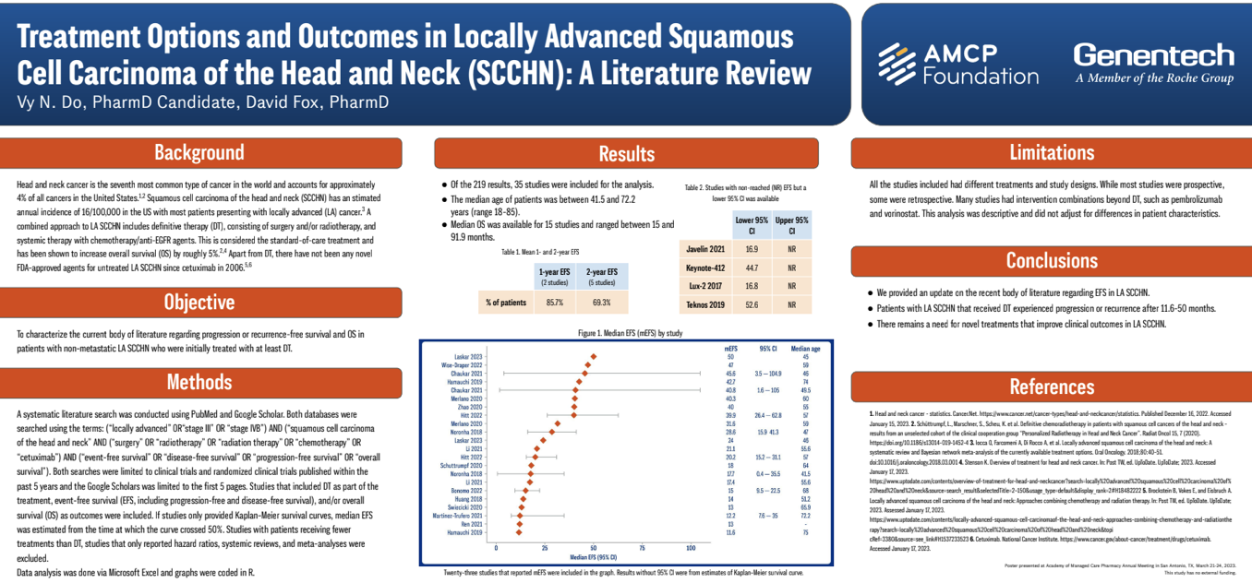
AMCP Foundation/Genentech Evidence for Access Internship
Fall 2022 & Spring 2023
Genentech
  US Medical Affairs
    Evidence for Access (E4A)
Manager: Pattie Strong
Preceptors:
  Komal Bawa, PharmD
  Aviva Nathan
  David Fox, PharmD
Additional projects:
  Polivy AMCP dossier
  AMCP Foundation journal club
Highlights
  Had a co-intern at the same site
  Had a voice in research project topic
  Tried (and failed) to code R
  Mock interviews with E4A team during residency application

Slide 12
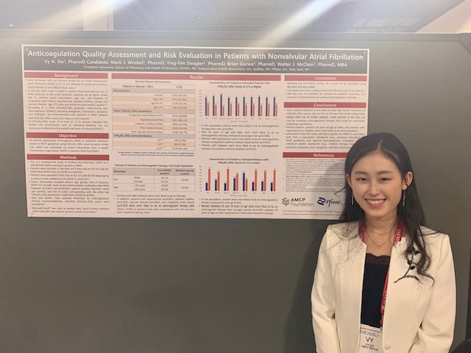
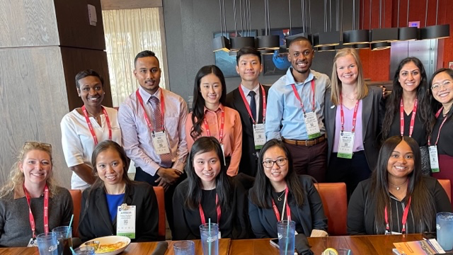
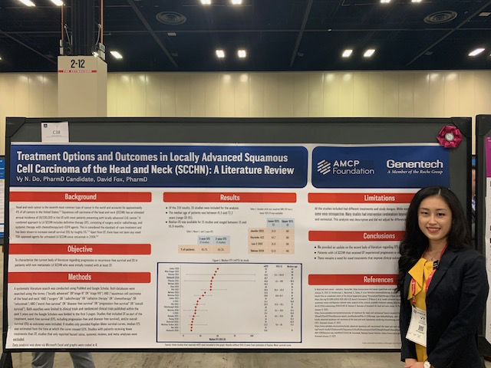
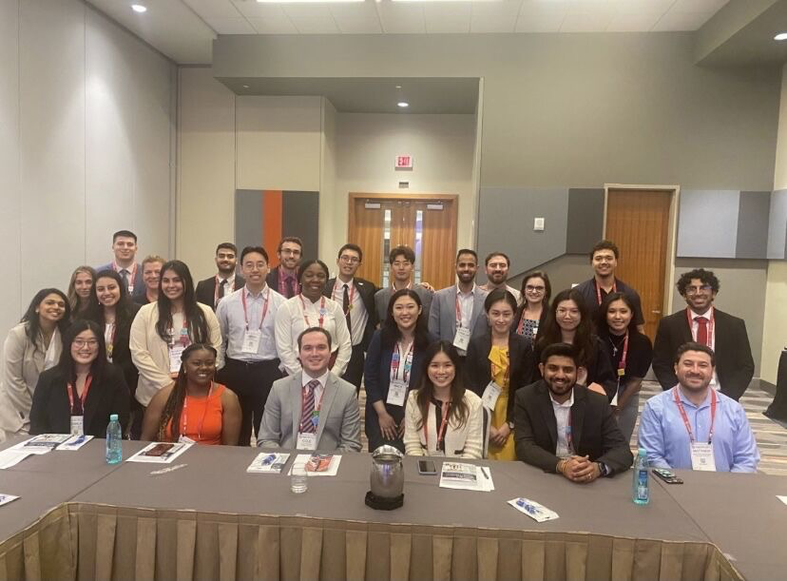
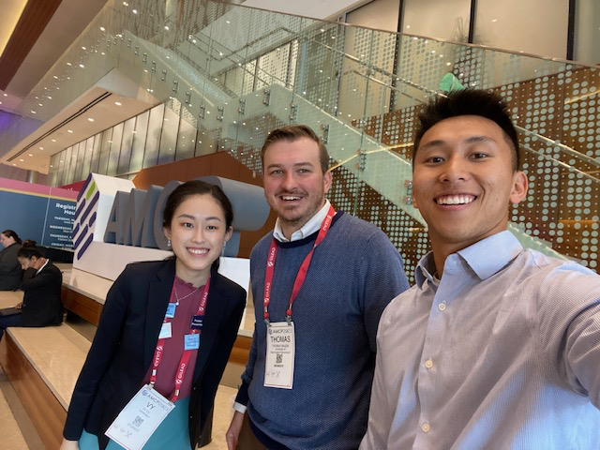
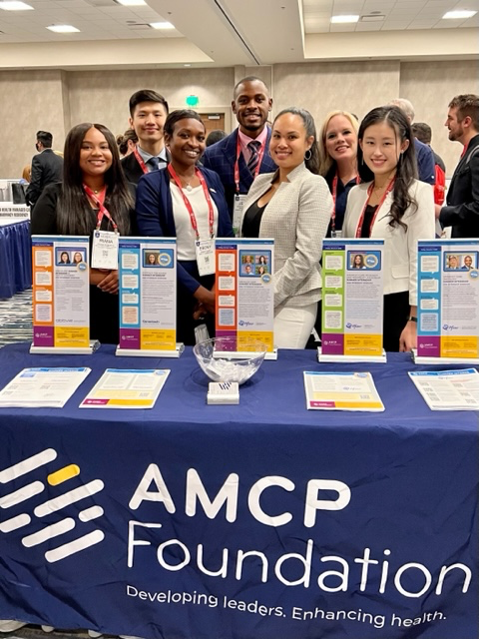
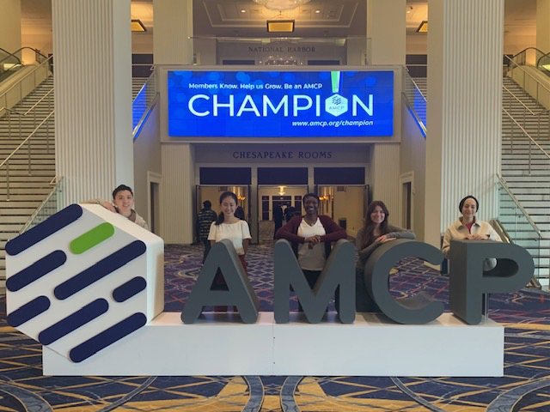
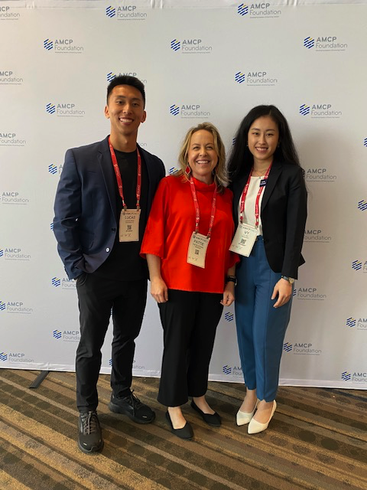
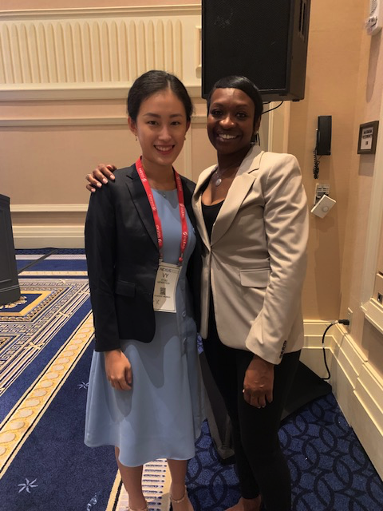
AMCP Nexus 2021, AMCP Nexus 2022, and AMCP Annual 2023
Notes:
Conference tips: go to CE sessions to learn about current topics, participate in residency/fellowship showcase, and most importantly – network!

Slide 13
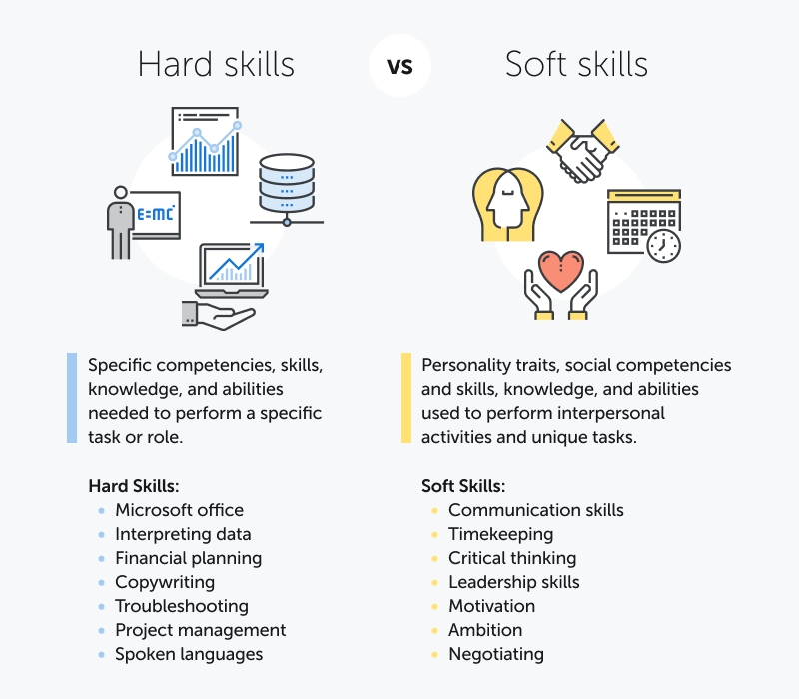
Key Takeaways
Research experiences
Presentation skills
Maintaining balance
Flexibility
Organizational awareness
Soft skills
Reflection

Slide 14
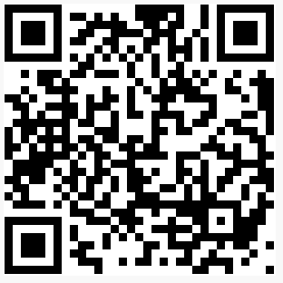
Vy Do, PharmD
Pharmacy Resident, Premera Blue Cross vndo1103@gmail.com
Contact Me

Slide 15



Jenoy Merchant, BSc, Pharm.D., PGY1 Resident, FAMU/BMS Pharmaceutical Industry Residency

Slide 16

Preceptors
Anna Brown, PharmD, BCOP Clinical Pharmacist Lead, Specialty Programs for Oncology at Humana
Amy Bryk, PharmD, BCOP, Clinical Pharmacy Lead, Specialty Programs and Infusion Strategies at Humana
Vivien Chan PharmD, GM and Director of Formulary and Contracting at Costco Health Solutions
Tom Wolfe, PharmD, Organized Customer Team Lead, Oncology Field Medical at Pfizer Oncology
Notes:
Original preceptor was AMY Bryk in the Pipeline Modeling and Forecasting Oncology Department
Mention Debbie Meyer and Aisha as well as Vicky Brown

Slide 17
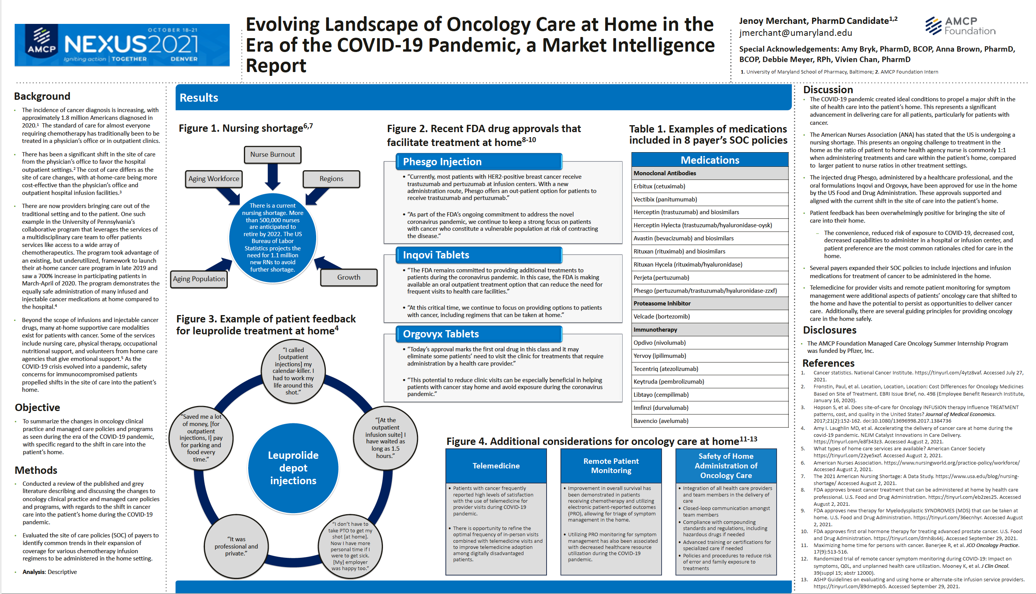
Capstone Project
The covid-19 pandemic played a major role in propelling the shift in the site of care into the patient’s home
Several payers expanded their site of care policies to include several oncology medications to be administered at home.
FDA approved Phesgo injection and Inqovi oral formulation to help facilitate treatment at home.
The current nursing shortage is a limitation to progressing this initiative/approach.
Overall, patients' feedback has been positive
ONS, COA, ASCO expressed reservations for safety and quality concerns.
Notes:
To obtain information, a general google search was conducted
Review of published and grey literature discussing the changes in oncology clinical practice, managed care programs and policies, with regards to the shift in care into the patient’s home.
So newsletters, commentaries, published articles etc. were evaluated to see if there were any of the mentioned changes present.
Evaluated the site of care policies (SOC) of payers to identify common trends in their coverage expansion to include various cancer therapies to be administered in the home

Slide 18
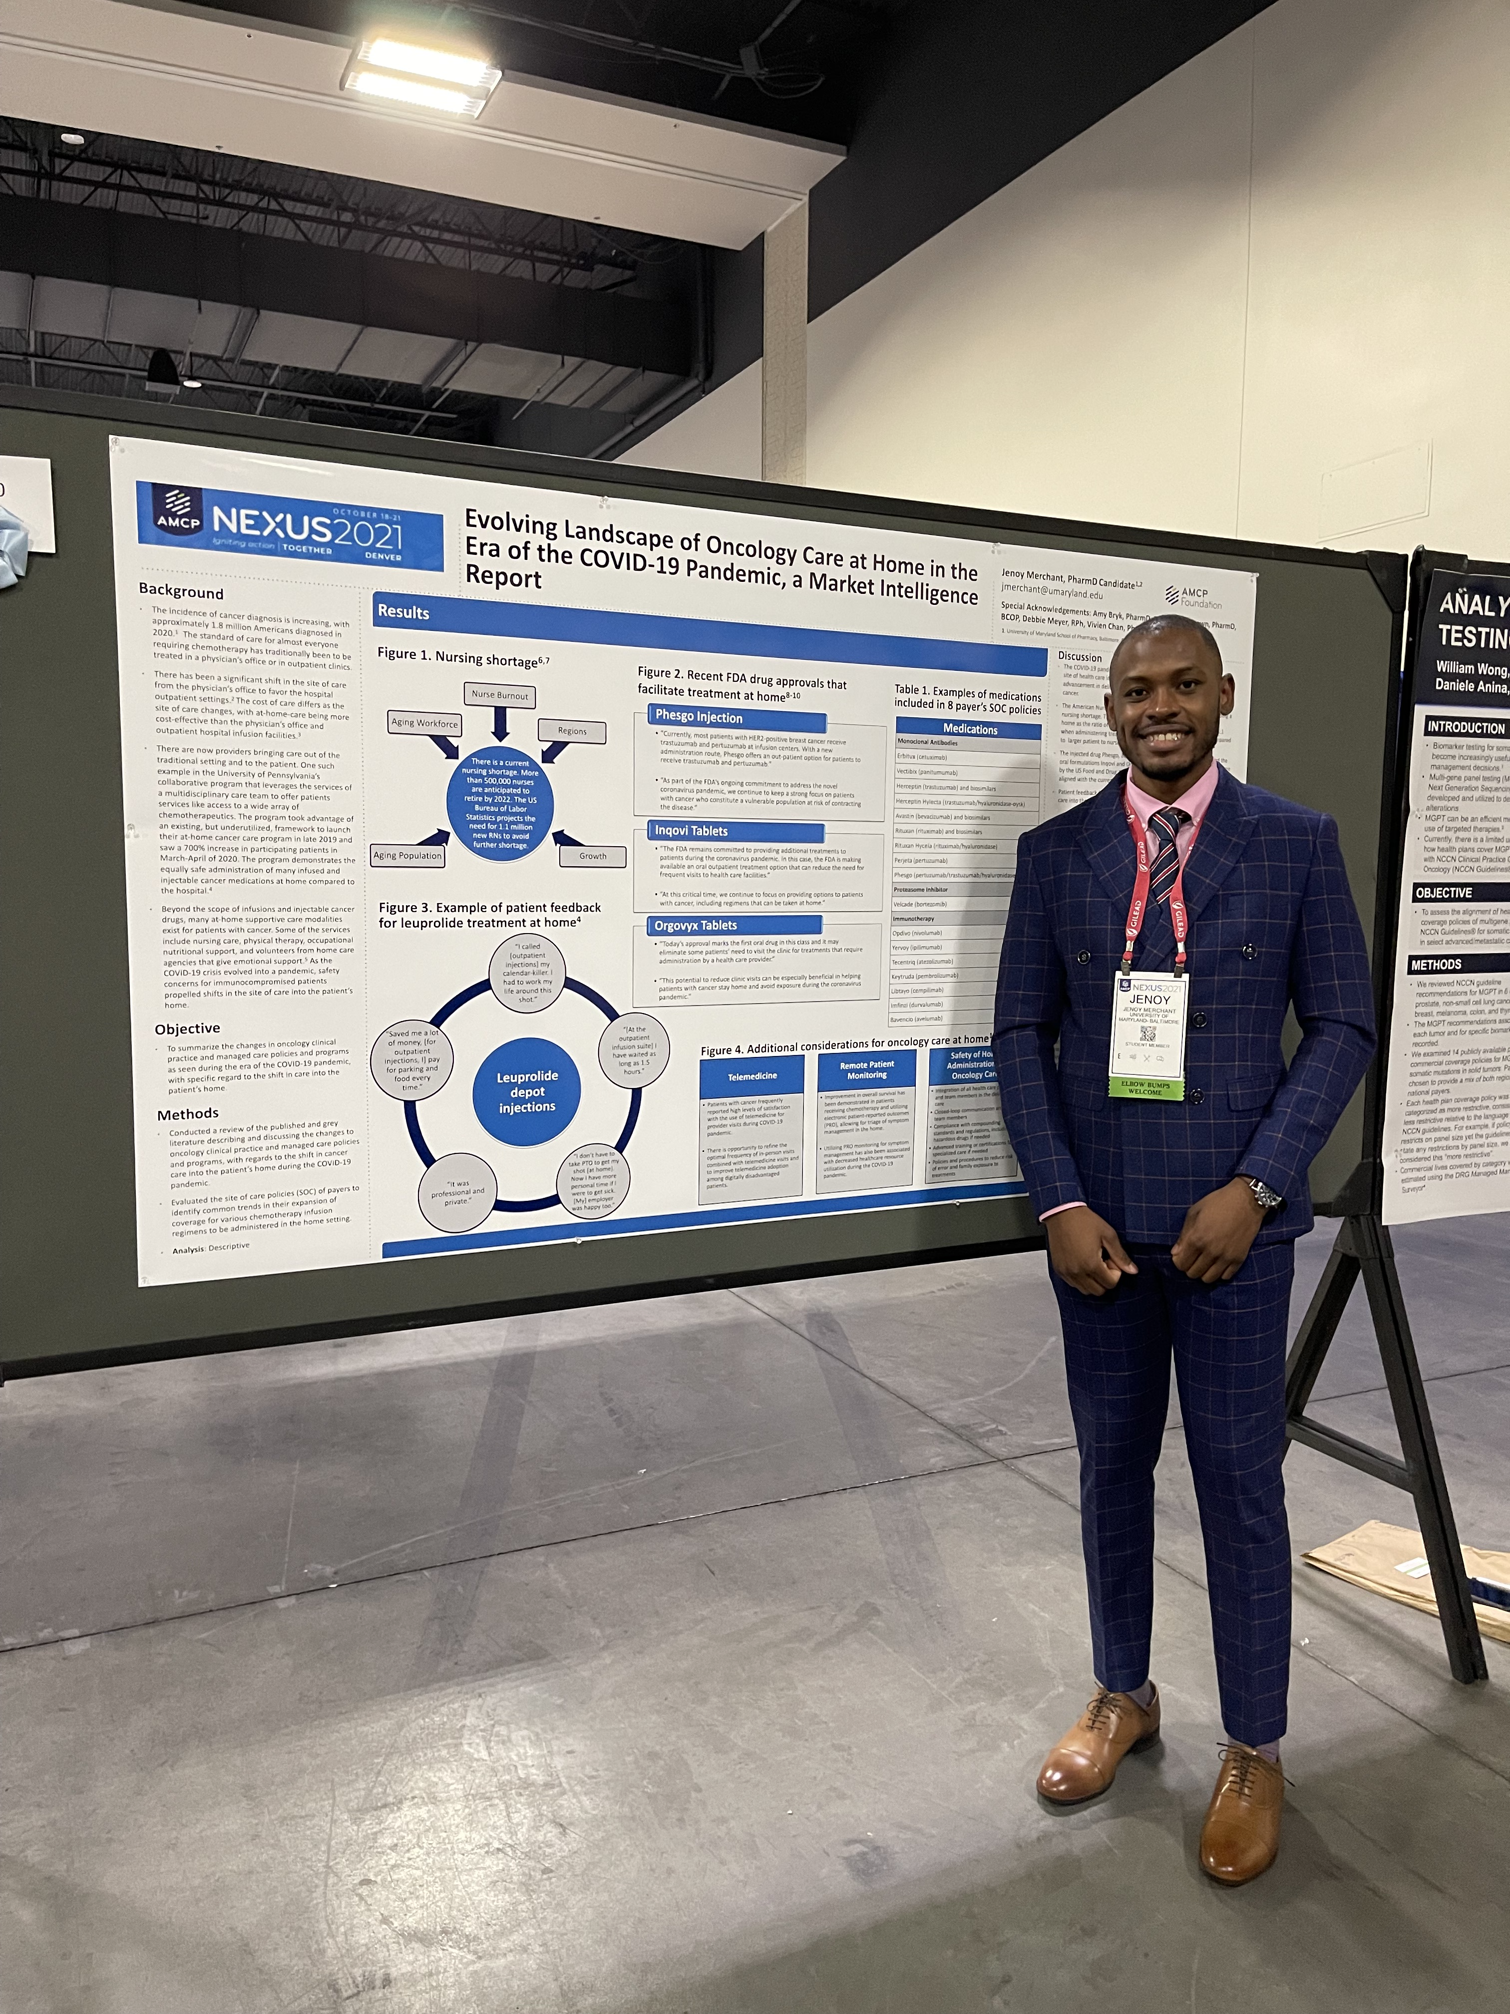
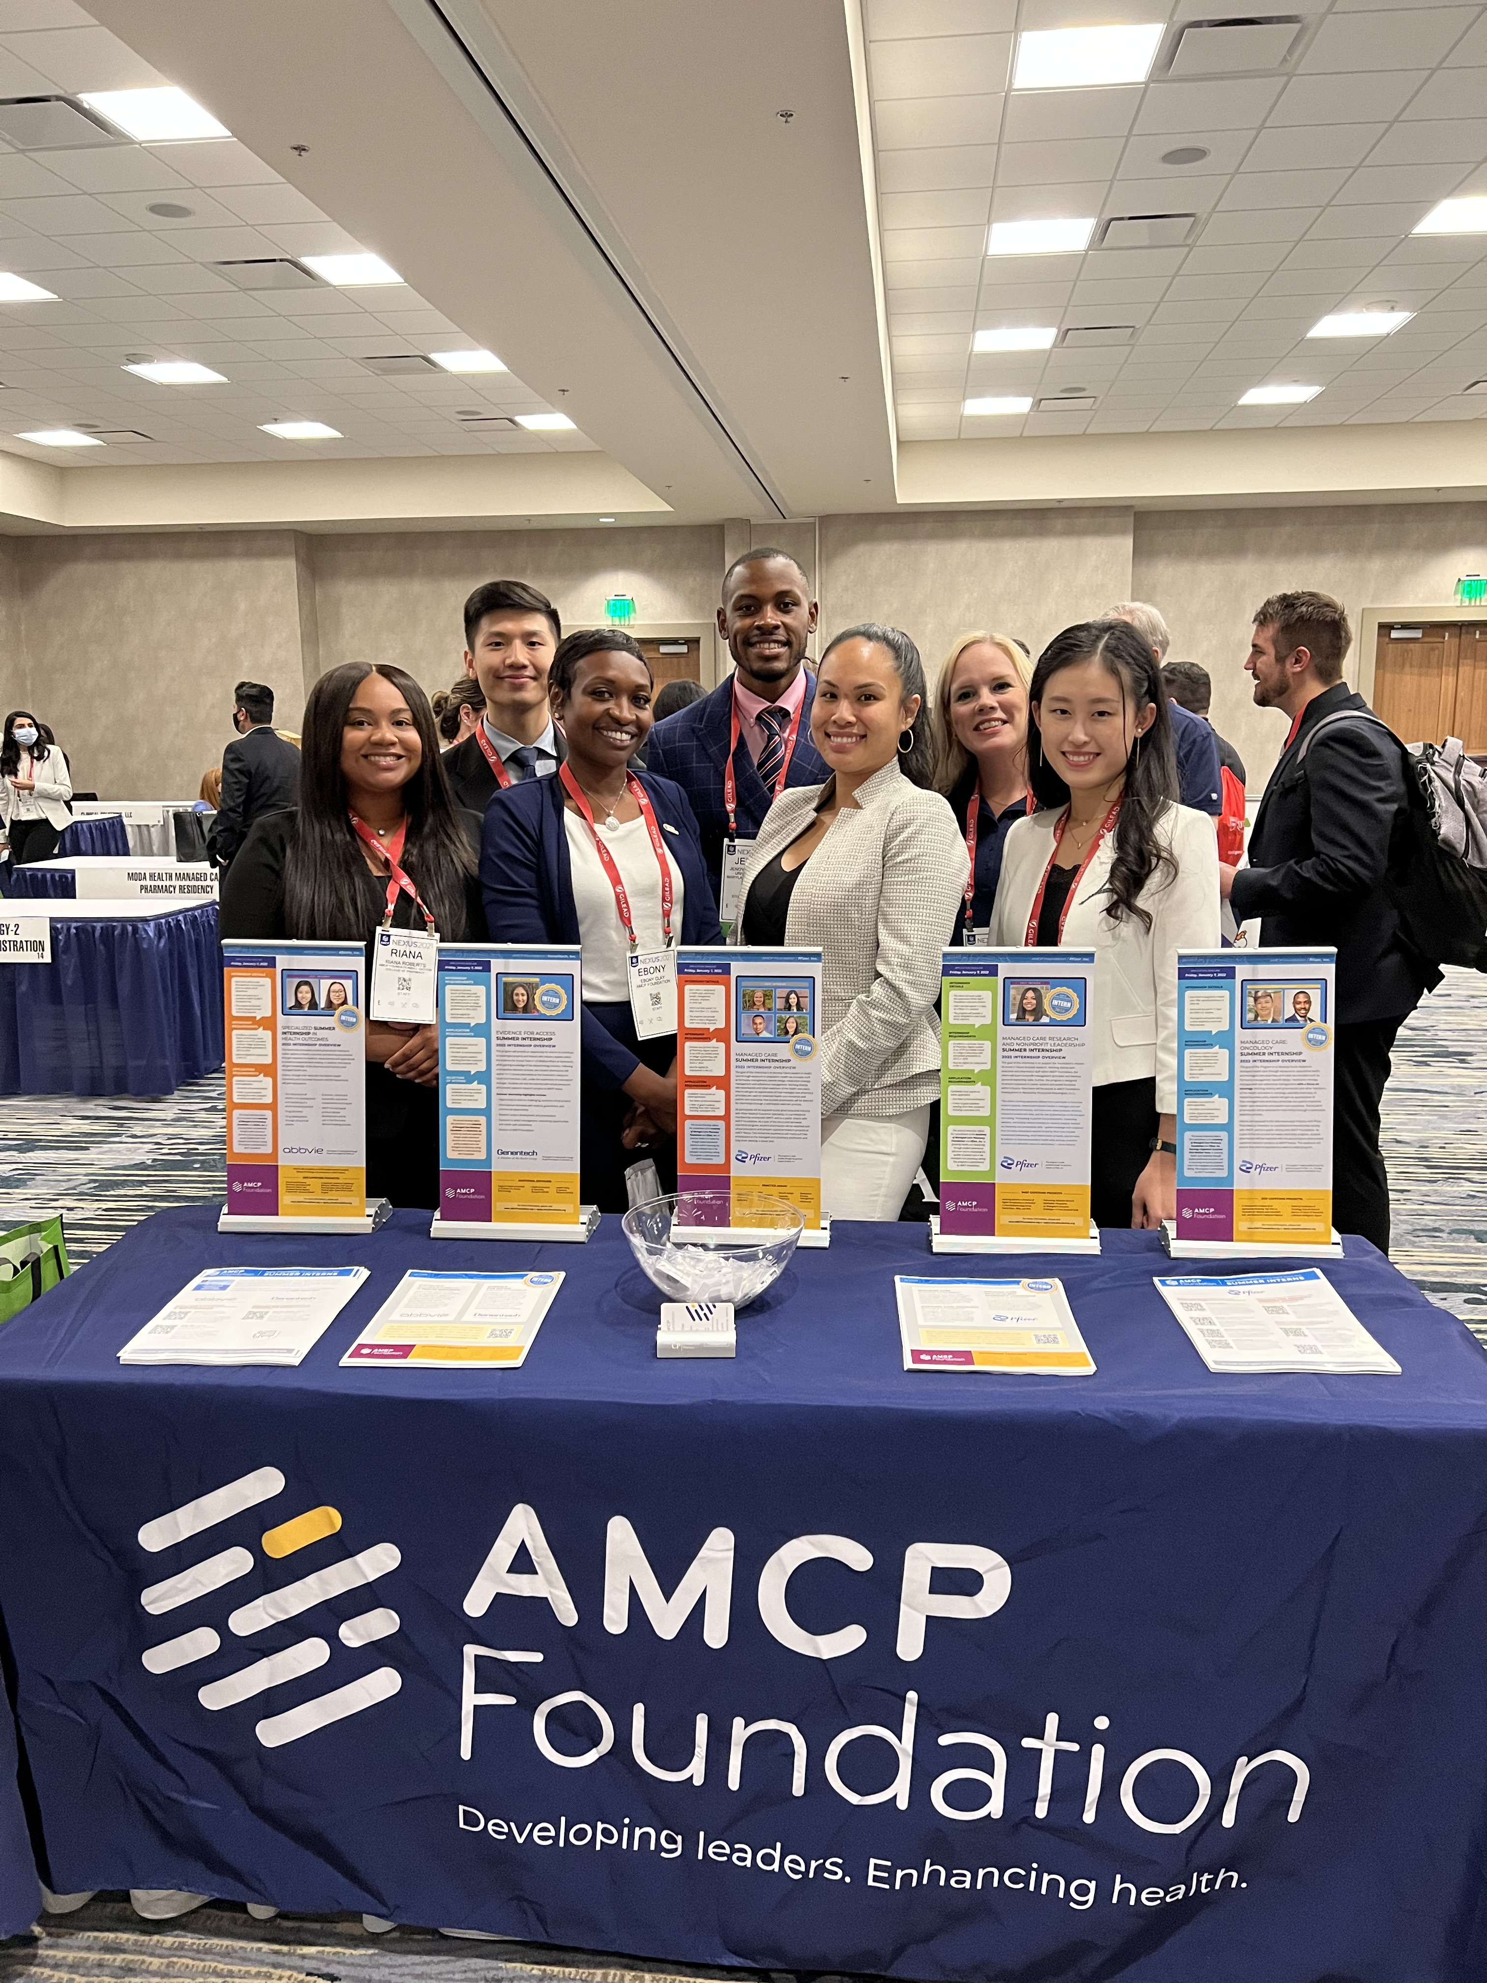
Presenting at AMCP Nexus
Notes:
Met with Debbie Meyer
Won the V

Slide 19
Additional Projects
Pipeline Modeling
Using information from various resources to predict launch dates of pipeline drugs
Forecast the revenue to be generated from certain products after launch
Evaluated whether certain drugs met the clinical and financial criteria to be modeled
ASP Pricing Forecast for PD-1/PD-L1 inhibitors
Assessed the relationship between the Wholesale Acquisition Cost (WAC) and Average Sales Price (ASP)
Presented at a monthly P&T meeting
Completed a Clinical Review
Market Intelligence Report for Oncology Drugs in various payer’s SOC policies
Journal Club
Humana
AMCP Foundation
Personal Brand Review
Specialty Pharmacy Shadowing
Collaboratively evaluated PA request and rationalized appropriate next steps
Notes:
ICER – Cornerstone of Fair drug coverage
Plethora of networking opportunities
Weekly one-on-one meetings with various individuals in different roles in Pharma facilitates by Pfizer
HEOR
MSL/FMD
FELLOWS
Bi-weekly meetings with my virtual preceptor Vivien Chan, discussing an array of topics from PBMs to my future.
Favorite thing about the internship was P&T and Nexus

Slide 20
Key Takeaways
Pharmacy is a small world!
Importance of mentorship
Always be open to learning
It is okay to not know everything, be honest with yourself
Network, Network, Network
There is more to managed care pharmacy than just payer engagement
Notes:
Managed Care Medical Science Liaison

Slide 21

Jenoy Merchant, BSc, Pharm.D., PGY1 Resident
Jenoy.Merchant17@gmail.com
Contact Me

Slide 22
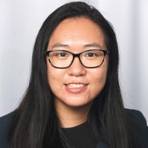

Amy Wu, PharmD, AESARA/UNC Market Access and Health Informatics Fellow

Slide 23
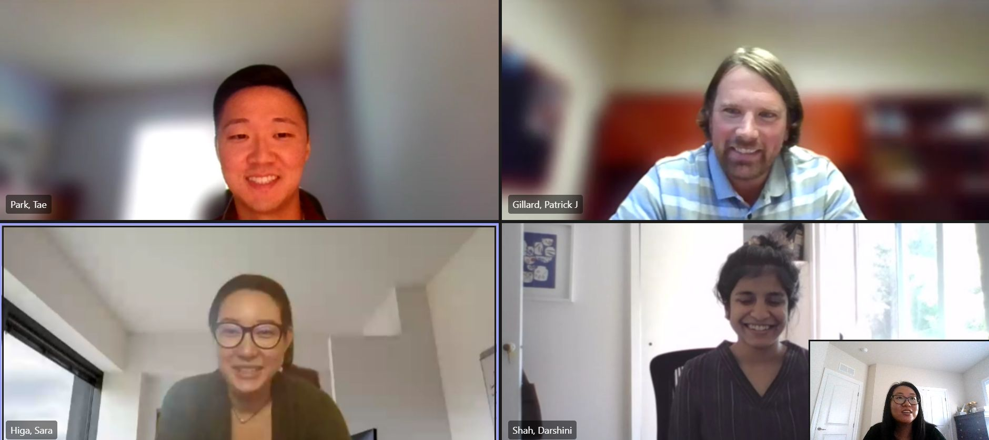
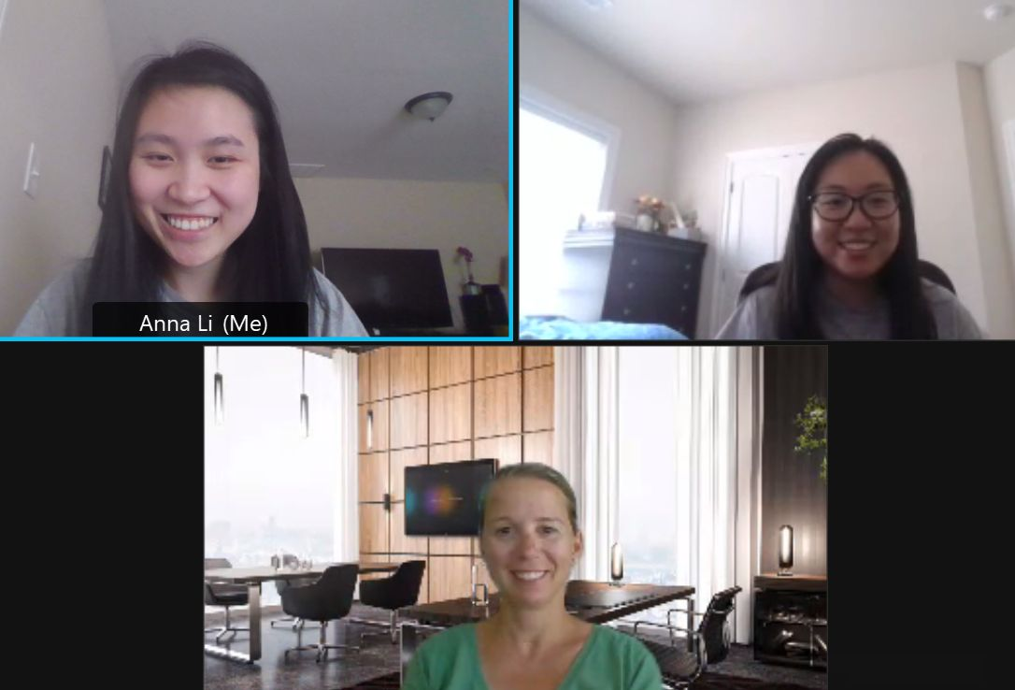
Preceptors
Sara Higa, PharmD, MS: Associate Director, HEOR, Agios Pharmaceuticals
Jaehyun Lee, PharmD: Associate Director, HEOR, Abbvie
Taejin Park, PharmD, MS: Senior Manager, HEOR, Abbvie
Elizabeth Hill, PharmD, MBA: Director, Professional Affairs, AMCP

Slide 24

Meeting and Professional Development
Weekly managed care topic meetings with preceptor
1 on 1’s weekly with management and preceptors
IHD and economic modeling training

Slide 25
Capstone Project
Healthcare Resource Utilization and Costs of Post-Operative Atrial Fibrillation Patients
  A systematic literature review to highlight the economic burden of post-operative atrial fibrillation early in drug development and support a program for novel botulinum toxin
  Findings presented at AMCP Nexus 2021

Slide 26
Other Projects
Literature review on economic consequences of pharmacy management policies for atypical antipsychotics
Presentation on FDA untitled enforcement letter and the importance of of real-world study design and non-misleading promotional communications
Economic modeling practicum to establish cost effectiveness of a malaria vaccine

Slide 27
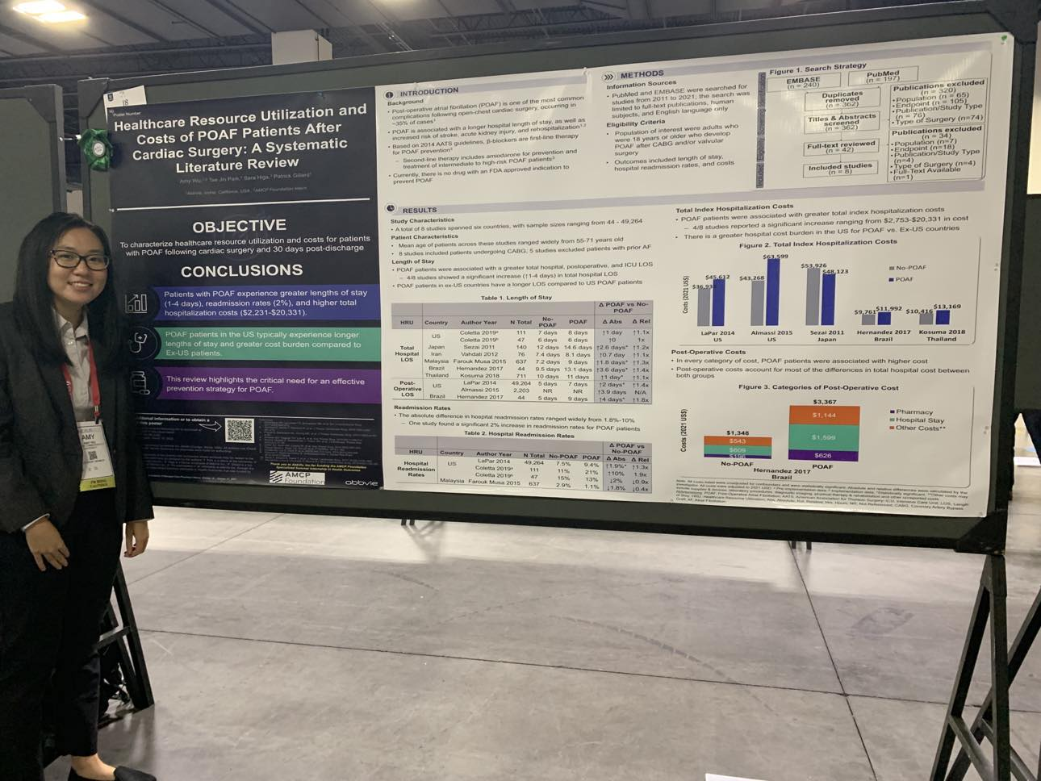
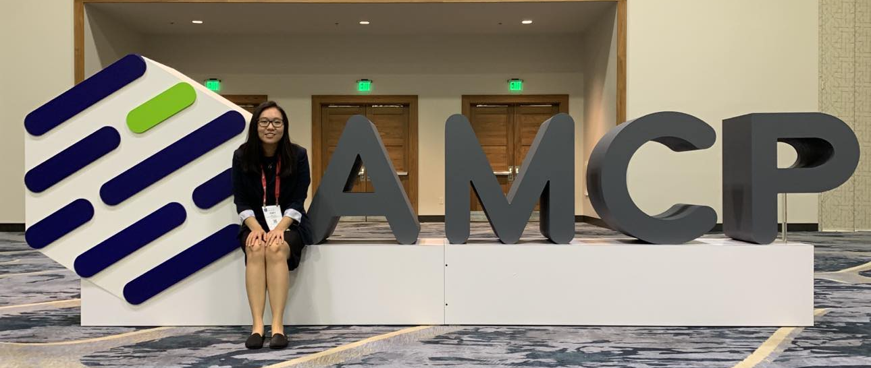
AMCP NEXUS Experience
Networking!
Presentation Skills
Connecting with AMCP co-interns

Slide 28

Internship Experience
Informational interviews
GHEOR/IHEOR meetings
Mentor & Intern Check-ins
Friday virtual happy hours
AMCP intern get togethers

Slide 29
Internship Impact
Network expansion
Research techniques
Presentation abilities
Understanding of HEOR & Pharma/Managed Care

Slide 30
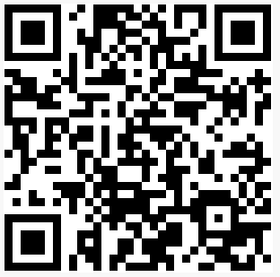
Amy Wu, PharmD, AESARA/UNC Market Access and Health Informatics Fellow amywu089@gmail.com
Contact Me

Slide 31
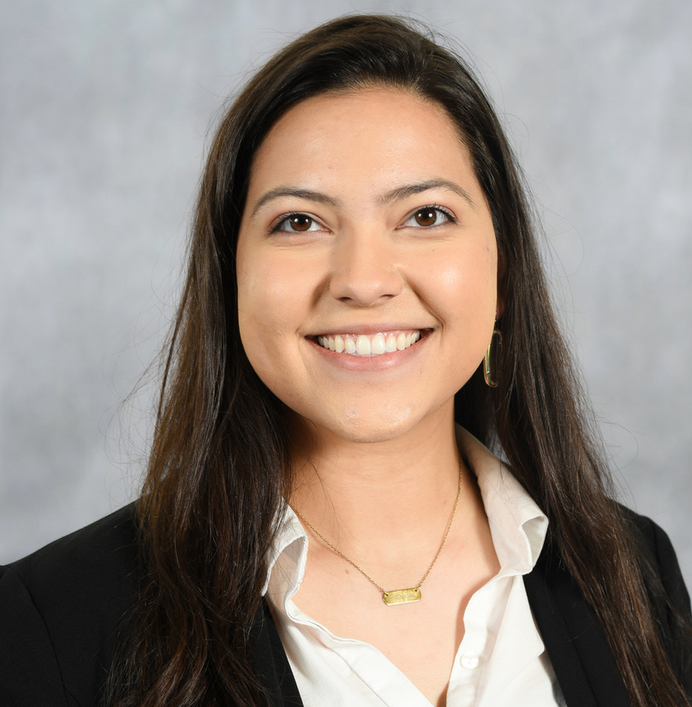

Raquel Erb, PharmD Candidate 2024
2023 AMCP Foundation/Sanofi Specialty Care Intern

Slide 32
Preceptors & AMCP Foundation Mentors
Blue Cross NC
Anna Bruckelmeyer, PharmD, BCPS; Clinical Team Lead, Specialty Pharmacy
Sanofi
Manny Nunez, PharmD, MS; Global Medical Director, Pipeline & Early Assets, Neurology & Immunology
AMCP Mentors
Charlene Dohanh, PharmD; MedImpact Clinical Program Manager
Michelle Rice; Former Executive of the National Hemophilia Foundation

Slide 33
Professional Development
Weekly/Biweekly Specialty Team Meetings
  Pharmacy Policy Implementation Review Committee (PPIRC)
  New to Market
  North Carolina-Prime Trade Meeting
1 on 1’s weekly with preceptors and other Sanofi professionals
Professional Development Leadership Committee

Slide 34

Internship Projects
Capstone: Quantity Limit Evaluation: Hemophilia Factor Products Dosing Optimization (completed findings will be presented at AMCP Nexus, Orlando, FL)
Collaborative project with other Blue Cross NC Pharmacy Interns with the Provider Engagement and Pharmacy Quality Team – Health Equity and Social Drivers of Health Initiative
UM Volume and Approval/Denial Rates Summary Table for Biannual Comparison with Horizon Blue Cross Blue Shield of New Jersey

Slide 35

Internship Highlights
Specialty Projects
  Specialty Definition Guidance
  Elevidys FAQ Document
  Humira Biosimilar Roll-Ins
Specialty Programs
  Medical Edits, Split Fills, etc.
  Hemophilia Network
  High Touch Pharmacist
Exposure to other LOBs and pharmacy teams
Carolinas AMCP Health Equity Summit
Blue Cross NC Summer Internship Expo

Slide 36
Key Takeaways
Opportunity to expand professional network
Presentation skills
Research techniques and study design
Experience operating virtually in a corporate/business environment

Slide 37
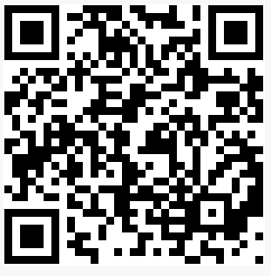
Contact Me
Raquel Erb
University of Texas at Austin College of Pharmacy
rskylaerb@utexas.edu

Slide 38

Ebony S. Clay, PMP
Assistant Director, Programs & Development
AMCP Foundation

Slide 39
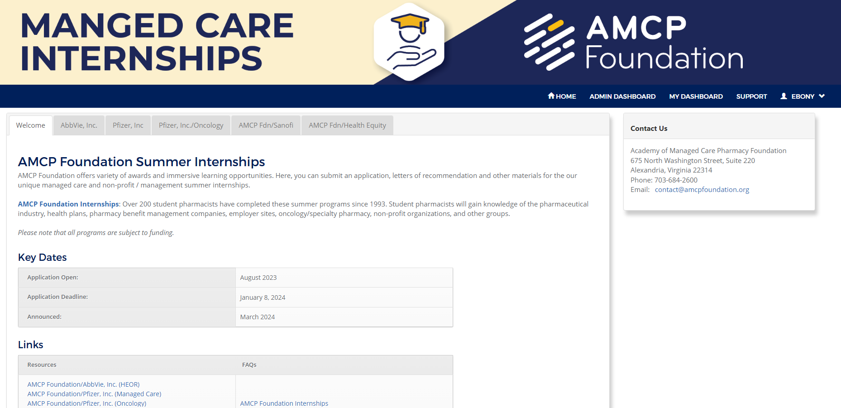
AMCP Foundation Internships: Now Accepting Applications
Applications for 2024 are available at https://apply.amcpfoundation.org/
Deadline: Friday, January 8, 2024

Slide 40
AMCP Foundation Internships: Before Applying
Know before you apply.
What internships are available? (All programs are subject to funding.)
What type of internship is it?
Industry Internships
  AMCP Foundation/AbbVie Specialized Internship in Health Outcomes (HEOR)
  Health Plans, PBMs, and Employer Groups
  AMCP Foundation/Pfizer, Inc. Managed Care Internship (Managed Care)
  AMCP Foundation/Pfizer, Inc. Oncology Internship (Oncology)
  AMCP Foundation/Sanofi Internship in Specialty Care (Specialty Pharmacy)

Slide 41
AMCP Foundation Internships: FAQs
Internship FAQs are available on our website. https://www.amcpfoundation.org/student-pharmacists/amcp-foundation-internships/faqs
Tips
Review thoroughly.
Ask us questions.
Reach out to former interns for guidance.

Slide 42
AMCP Foundation Internships: FAQs
Internship FAQs are available on our website.
https://www.amcpfoundation.org/student-pharmacists/amcp-foundation-internships/faqs
Common FAQs
Can I apply for multiple programs? YES
How long is the internship? 10 Weeks
  Internship is a full-time commitment.
Are the programs virtual? YES
  Travel to Nexus is required.
Does this internship qualify as a specialty rotation? YES
  School must approve specialty or general elective rotation before the internship begins.

Slide 43
AMCP Foundation Internships: Prepare Now
Tips
Research your program(s) of interest.
Start your application(s) now.
Request letters of recommendation & letters of good academic standing on school letterhead.
Start researching essay prompts.
  Essay prompts are available for review on each internship page on our www.amcpfoundation.org.

Slide 44
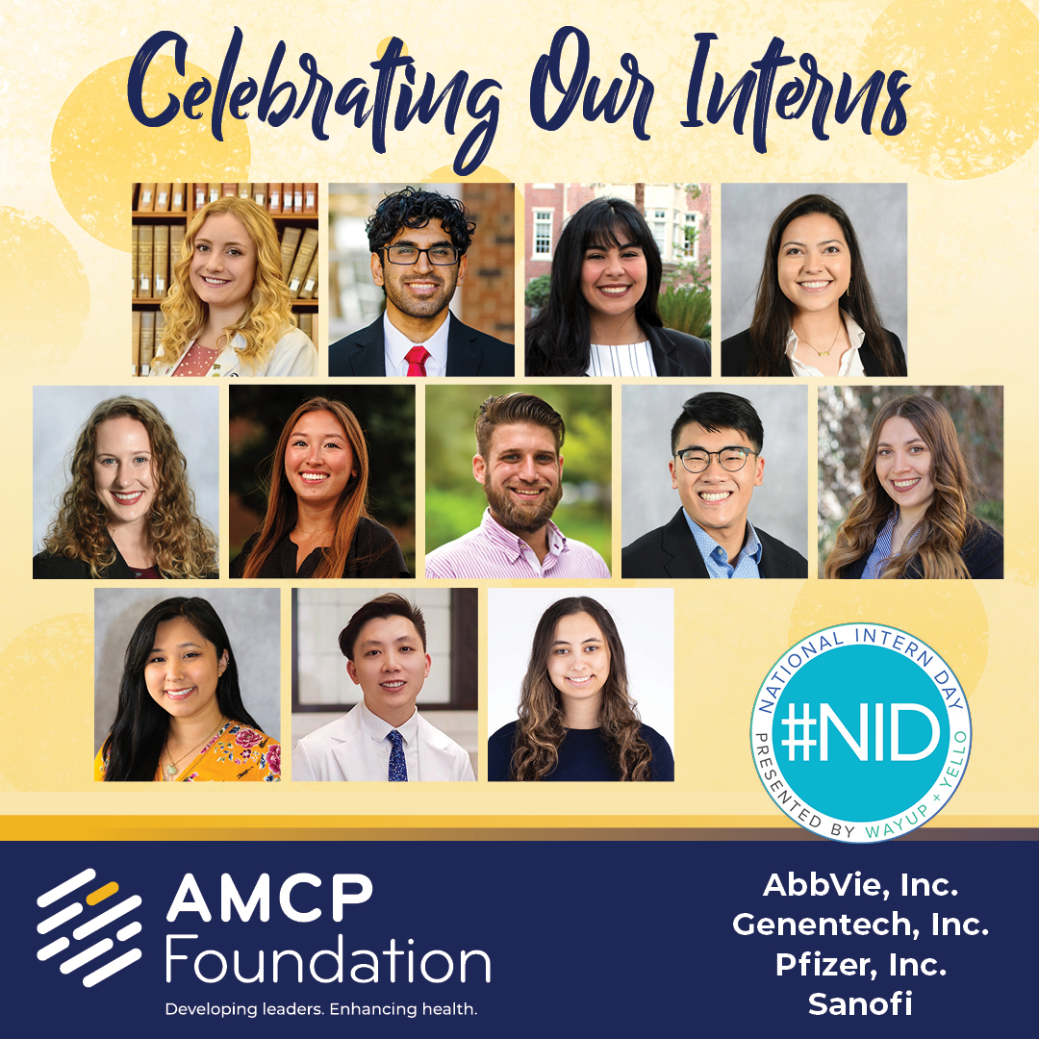
Congratulations Class of 2023!

Slide 45
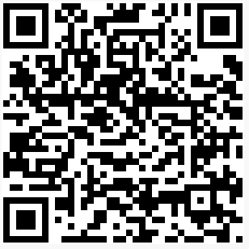
Contact Me
Ebony S. Clay, PMP
Assistant Director, Programs & Development
eclay@amcpfoundation.org

Slide 46

Notes:
Paula

